Slide 1
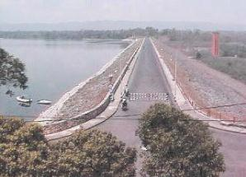
Towards Excellence River Basin Organization
Case of Brantas River Basin East Java - Indonesia
National IWRM Workshop
New Delhi, 2 – 3 February 2015
Presented by:
Tjoek Walujo Subijanto
Former President Director, Jasa Tirta I Public Corporation
Senior Advisor, Network of Asian River Basin Organization (NARBO)
Independent Senior Professional Engineer on WRM
Sertifikat No. Q9755
Notes:
I would like to express my gratitude to the Government of India and to World Bank Representative Office in India ,especially to Dr. Wilam Young, who invite me to participate in this important workshop on IWRM.
My name is Tjoek Walujo Subijanto from Indonesia
I have worked for about 40 years in the Brantas River Basin, Indonesia

Slide 2
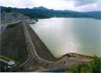
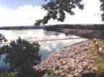
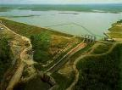
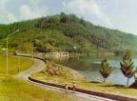
Curriculum Vitae Tjoek Walujo Subijanto
3. Senior Professional on WRM (Nov’12 – up to now)
2. Jasa Tirta Public Corporation (April’91 – Nov’12)
Nov’07 – Nov’12 : President Director (retired 23 Nov’12)
Nov’01 – Nov’07 : Director of Operation for Brantas River
Jan’93 – Nov’01 : Chief of R&D Bureau
Apr’91 – Jan’93 : Chief of Bureau on Mng. System & Water Business
1. Brantas River Basin Development Project (Dec’72 – Apr’91)
Jul’88 – Apr’91 : Chief Program Implementation Bureau, HO
Oct’85 – Jul’88 : Chief Technical Planning Bureau on Dam, Electricity & Utilities , Head Office (HO)
Mar’82 – Oct’85 : Project Manager Parit Agung Canal, Tulung Agung Project
May’81 – Mar’82 : Deputy Manager Planning & Programming, Tulung Agung Project
Mar’78 – May’81 : Electronic Data Processing Centre , HO
Dec’72 – Mar’78 : System & Procedures, HO
Notes:
In 1972 up to 1991, I worked at Brantas Project who responsible in the development of water resources in Brantas River Basin.
Starting from 1991 up to 2012, I worked at Jasa Tirta I Public Corporation. the government owned company who manage the water resources in Brantas River Basin and Bengawan Solo River Basin in Indonesia.
I retired in November 2012 as the Presiden Director of this corporation.
I actively participate in the Network of Asian RBO since its establishment in February 2004. I appointed as Vice Chairman of NARBO in 2010 up to 2012. I’m now as Senior Advisor of NARBO.

Slide 3
Structures of Presentation
I. Introduction
II. The Brantas RB during Development Era (1961 – 1990)
Water Resources Development
Capacity Development of Brantas RBO
Performance of Brantas RBO
III. The Brantas RB during Management Era (1991 – now)
Jasa Tirta I Public Corporation (PJT I)
WRM Implementation in the Brantas RB
Capacity Development of PJT I
Performance of PJT I
IV. Conclusion
Notes:
My presentation structures compose:
1st Introduction:
I will share about basic WRM Functions, key success factors on effective IWRM implementation, and notion of CD.
2nd Brantas River Basin during Development Era (1961 – 1990):
In this part, I will describe about WRD in the basin, the One River, One Plan – One Management principle, the master plan, and the benefits of WRD. After that, I would like to share the CD program adopted and the performances in the achievements of Brantas Project to implement their tasks and responsibilities effectively, especially in achieving their vision, to be “the home of the dam builders” for national wide.
3rd Brantas River Basin during Management Era (1991 – now)
In this part, I will share you about Jasa Tirta I Public Corporation, the Brantas RB Management Agency, their challenges, the CD adopted, WRM functions implemented in the basin and some performance that indicate PJT I achievements toward their vision “to be one of the best RBO in Asia Pacific by 2025”.
4th Conclusions
I hope that OC had prepare printed copy of my paper. Due to limited time allocated for my presentation, I will only take some important aspects for my presentation

Slide 4
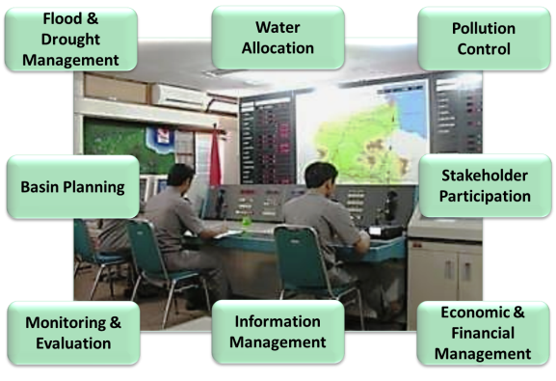
I. Introduction
1.1. Basic Function of WRM
CapNet, 2008. IWRM for RBO: Training Manual
Functions of WRM very complex tasks conducted by different players in a different level
No single organization can implement effectively all WRM functions
Notes:
To implement WRM on the river basin scale effectively, we should focus on a set of basic WRM functions. The suggested basic functions for WRM in a river basin includes: flood and drought management, water allocation, polluter control etc. supported by cross cutting functions: planning, monitoring & evaluation, information management, financial management and stakeholders participation.
Functions of WRM are very complex tasks and involve many different activities conducted by many different players in a different level. No single organization can implement effectively all WRM functions. The organizational framework is dependent on the national policies.

Slide 5
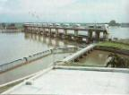
I. Introduction
1.2 Effective IWRM Implementation
Adaptive-collaborative process is one of basic essence of IWRM and it will be the key success factor of effective IWRM implementation.
High quality of participation needs capability to positive participations i.e. active and constructive participations
WRM Coordination bodies should be established
Effective implementation of IWRM will:
promote transparent and efficient WRM;
facilitate effective conflict resolution;
encourage better water conservation and demand mng;
develop ownership of stakeholders; and helps to maintain the sustainability of water resources to for human being and ecosystems in future.
Notes:
Achieving sustainability of water requires cooperation between various stakeholders in all levels. Therefore, adaptive - collaborative process of WRM through participatory management involving stakeholders, one of basic essence of IWRM, will be the key success factor of effective IWRM implementation.
The quality of stakeholder’s participation is the most crucial factors in participatory management. High quality of participation needs capability to positive participation i.e. active and constructive participation.
WRM Council or other name of coordination bodies should be established as a platform for stakeholder liaison and an advisory body, as a forum for coordination and consultation, for integration and synchronization of all interests in WRM.
Effective implementation of IWRM will promote transparent and efficient WRM, facilitate effective conflict resolution, encourage better water conservation and demand management, develop ownership of stakeholders; and helps to maintain the sustainability of water resources in order to sustain the human being and ecosystems in future.

Slide 6
I. Introduction
1.3 Capacity Development in RBO
Capacity is the “capability" to perform functions efficiently, effectively and sustainably;
CD is a process of transformative change. Takes place in a continuous and complex process.
CD programs are more successful and more likely to be sustainable when they respond to an internal initiative.
Strong leadership is fundamental to build willingness and ownership. Incentives play important part in transforming capacity into performance.
Successful of CD initiatives depend also on the commitment and consistency the peoples within the organization to develop, strengthen and maintain their organization cultures.
Notes:
The notion of capacity is normally associated with individual, organizational and societal “capabilities” to perform functions effectively, efficiently and sustainably.
The is far more than a development of technical competencies but a process of transformative change that takes place in a continuous and complex process.
CD programs are more successful and are more likely to be sustainable when they respond to an internal initiative.
And, strong leadership and political commitment are the most fundamental attributes to build willingness and motivation to participate for assuring a locally driven process of the CD initiatives.
How effective, efficient and sustainable the capacity development initiatives is depend also on the commitment and consistency of management and employees to develop, strengthen and maintain their organization culture.
Organization cultures is a set of collective behavior as a reflection of beliefs, values, and norms that should be maintain in the organization.

Slide 7
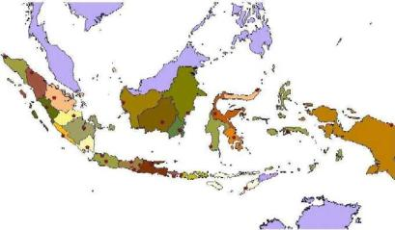
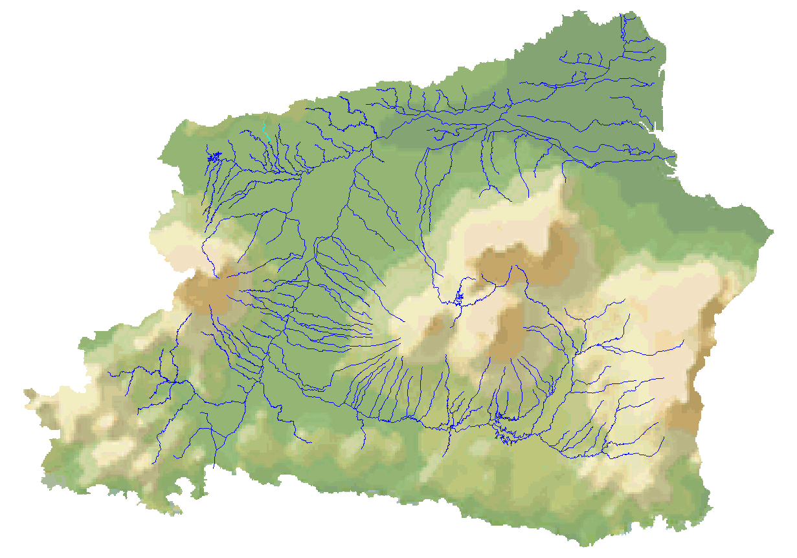
II. Brantas RB during Develoment Era
2.1. Water Resources Development
(1/3)
Surabaya
Bening Dam
Kediri
BRANTAS RIVER BASIN, EAST JAVA, INDONESIA
Catchment Area : 11,800 km² (25% of East Java)
Population (2010) : 15.6 million (43% of East Java)
Annual Rainfall : 2,000 mm
Annual Runoff : 11.8 billion m³
Mainstream Length : 320 km
Selorejo Dam
Malang
Wonorejo Dam
Wlingi Dam
Sengguruh Dam
Lodoyo Dam
Sutami Dam
Notes:
The Brantas River having 320 km long is characterized by clockwise watercourse centering on Mount Kelud. The Brantas originates from the southeastern side of Mount Arjuna located in the center of its basin. The Brantas travels past major volcanic ranges in the basin.
The Brantas River Basin has 11.8 km2 and it is about 25% of East Java Propvince area. The population in 2010 is about 15.8 million inhabitant or about 45% of East Java population. The Brantas RB area is the center of economic activities of the province

Slide 8
II. Brantas RB during Develoment Era
2.1. Water Resources Development
(2/3)
Modern WRM in Brantas RB was introduced after GoI requested GoJ to prepare a comprehensive WRD Plan (1960) based on “One River – One Plan – One Management”.
The plan was reviewed periodically to be updated accordance to basin emerging issues and national development requirements.
Notes:
Modern WRD in the Brantas RB was introduced after GoI requested the preparation of a comprehensive WRD plan to GoJ.
WRM should be undertaken integrated, comprehensive, and sustainable manner based on master plan with the river basin as one of management unit. These principles are known as One River, One Plan, and One Management principle.
The master plan was periodically reviewed to update the plans accordance to the basin emerging issues and national development requirements.
Master Plan I (1961), emphasized mainly on flood control (main issues of the RB)
Master Plan II (1973), emphasized mainly on irrigation dev. to support national food sustainability program
Master Plan III (1985) emphasized mainly on WS for domestic and industrial uses to support the government policy on industrialization.
Master Plan IV (1998), emphasized mainly on conservation and effective WRM to face the challenge of environmental degradation & effective water governance.

Slide 9
II. Brantas RB during Develoment Era
2.1. Water Resources Development
(3/3)
7 dams & reservoirs,
6 barrages and gates,
4 river-improvement-schemes,
3 rubber dams etc.
Net asset value (in2000):
IDR 7.4 trillion (USD 869 M)
Notes:
During 30 years, WRD in the basin resulted into:
7 (seven) dams and reservoirs,
6 (six) barrages and gates,
4 (four) river-improvement-schemes,
3 (three) rubber dams etc.
The total investment was about IDR 7,400 billion or about USD 869 million (based on 2000 price level).
The development of the basin is a comprehensive multipurpose project, which uses dams, and reservoir for development of water resources, resulting benefits in flood control, irrigation, and power generation, domestic and industrial water supply

Slide 10
II. Brantas RB during Develoment Era
2.2. CD of Brantas Project
(1/8)
The Challenges & the Strategic CD Programs
Former Minister of PWEG, 1960’s: “The Brantas Project has to be the home of the dam builders”. It was very challenging.
The strategic programs adopted:
Contracting systems and direct force method;
Appropriate transfer of knowledge mechanism; and
Appropriate management system.
The driving factors to implement strategies:
Strong Government support and wider authority;
Strong leadership,
Spirit and culture; and
Incentive scheme.
Notes:
The Challenge:
Former Minister of Public Works and Electrical Energy, 1960’s, Ir. Sutami: “The Brantas Project must not fail. He is the Flag Carrier of Ministry of Public Works and Electrical Energy and to be the home of the dam builders”.
In 1960’s, when Indonesian engineers have no experience in building big dams, “to be the home of the dam builders” was very challenging. It will bring about institutional change, adoption of appropriate management system, culture and method of human capital accumulation..
The strategic programs adopted:
Contracting systems and direct force method;
Appropriate transfer of knowledge mechanism;
Training at the universities; and
Appropriate management system.
The driving forces to implement strategies are:
Strong Government support and wider authority;
Strong leadership;
Appropriate spirit and culture; and
Incentive schemes.

Slide 11
II. Brantas RB during Develoment Era
2.2. CD of Brantas Project
(2/8)
(a). Contracting Systems and Direct Force Method
The Brantas Project applied unique contracting systems.
(1) Phase I (1961 ~ 1964)
Period “to see” how the foreign consultants and contractors do the work on a “full contract basis”.
(2) Phase II (1965 ~ 1969)
Period “to try” to do the work, “assistance concept” for consulting services and “guidance engineer concept” for construction works.
(3) Phase III (1970 ~ 1990)
Period “to do” design and construction work by “force account” basic, supervised and guided by limited number of foreign engineers.
(4) Phase IV (1991~ Present)
Period “to oversee or supervise”. The Brantas Project supervised all the operations of the project.
Notes:
The management of the Brantas Project employed unique contracting systems.
(1) Phase I (1961 ~ 1964)
This was the period of “to see” how the foreign consultants and contractors do the works based on a “full contract basis”.
(2) Phase II (1965 ~ 1969)
This was the period of “to try” to do the work by themselves with the assistance of a limited number of foreign engineers based on “assistance concept” for consulting services and “guidance engineer concept” for construction works.
(3) Phase III (1970 ~ 1990)
This was the period of “to do” design and construction work. The projects were implemented by Indonesian engineers and technicians on “direct force or force account” basic under supervision and guidance of a limited number of foreign consultants and guidance engineers.
(4) Phase IV (1991~ Present)
And this was the period of “to oversee or supervise” all the operations of the project.
This was “learning –by-doing” process from “to see – to try – to do and to oversee” the project.

Slide 12
II. Brantas RB during Develoment Era
2.2. CD of Brantas Project
(3/8)
(b). Transfer of Technology and Knowledge
The major method of knowledge transfer was the OJT. A man-to-man approach , “work-together, discuss-together, eat-together and relax-together” contributed not only to accelerate transfer of technology, but also create strong trust between them.
Fortunately, the Brantas Project could assign the consultant repeatedly, by which the technology was solidly transferred. Nippon Koei Consulting Services was the one and the only consultant played an important role in training the local engineers.
Notes:
The sequence of contracting system aimed to have Indonesian workers acquire technologies in an efficient and effective way.
The major method of knowledge transfer was the OJT (on the job training) using a man-to-man approach of “work-together, discuss-together, eat-together and relax-together”. This approach contributed not only to accelerate transfer of technology, but also to create a strong trust between them.
It was fortunate that the Brantas Project could assign the consultant repeatedly, by which the technology was solidly transferred. The one and the only consultant, Nippon Koei Consulting Services, played an important role in training the local engineers.

Slide 13
II. Brantas RB during Develoment Era
2.2. CD of Brantas Project
(4/8)
(c). Effective management system
Government authorized the Brantas Project to develop and implement their own mng. system to do the project in efficient and effective manner.
Innovative management had been introduced, such as:
participatory management in the decision making processes,
management by objectives,
merit system, performance based salaries, and other incentive based schemes,
modern accounting system to improve,
effective internal control which aimed to ensure that “everybody works correctly and appropriately”.
Notes:
The government authorized the Brantas Project to develop and implement their own management system to do the project in efficient and effective manner to realize their mission.
Innovative management and methods had been introduced, such as:
participatory management which encouraged upper, middle and lower level employees to participate in discussions and be involved in the decision making processes,
management by objectives,
merit system, performance based salaries, and other incentive based schemes,
modern accounting which improved office budget control considerably,
effective internal control which aimed to ensure that “everybody works correctly and appropriately”.

Slide 14
II. Brantas RB during Develoment Era
2.2. CD of Brantas Project
(5/8)
(d). Driving Factors
(1). Strong Government Supports and wider Authority
The government give a strong political will for the successful implementation of the projects and in producing professional engineers and technicians in dams construction for the country.
The government provided the Brantas Project substantial authority on rational project management and human capital accumulation.
Brantas Project was the only Government WRD Project having authority to apply “Direct Force” or “Force Account” system.
Brantas Project could directly recruit, hire, train and supervise the workforce and responsible for the policies governing the wages and salaries.
Notes:
(1). Strong Government Supports and wider Authority
The Brantas Project was given the highest priority in the national development plan. The government give a strong political will to implement these projects and successfull achievement in producing professional engineers and technicians in dams construction for the country.
The Government provided the Brantas Project with substantial authority in adopting a rational project management and human capital accumulation through project experience.
The Brantas Project was the only Government WRD Project who apply “Direct Force” or “Force Account” system, meaning that the Brantas Project could directly recruit, hire, train and supervise the workforce and be responsible for the policies governing the wages and salaries.

Slide 15
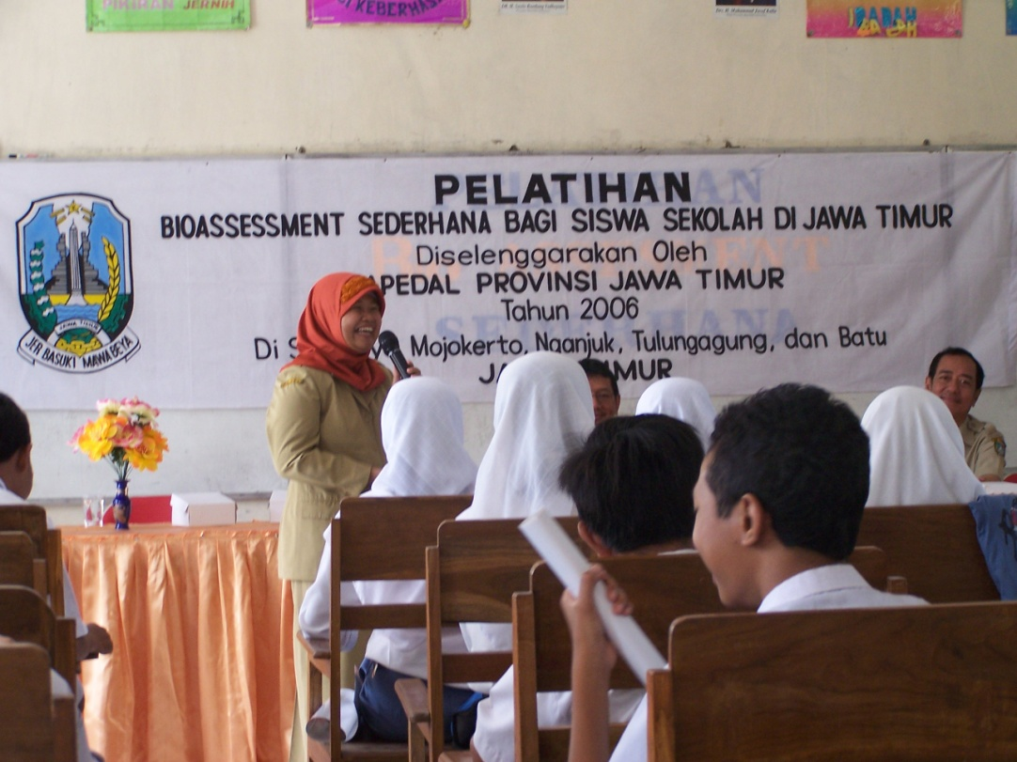
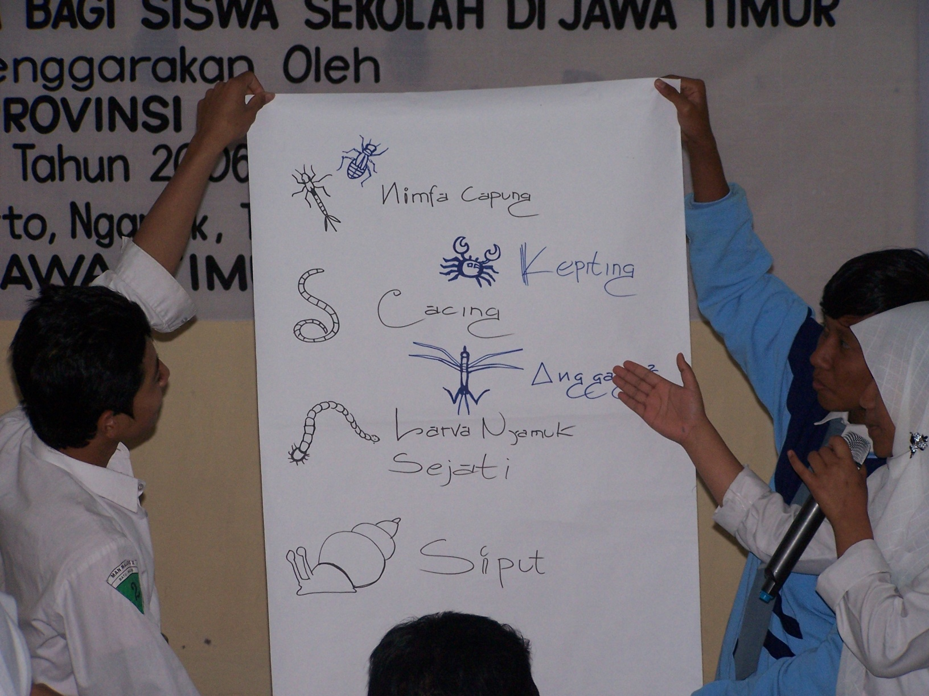
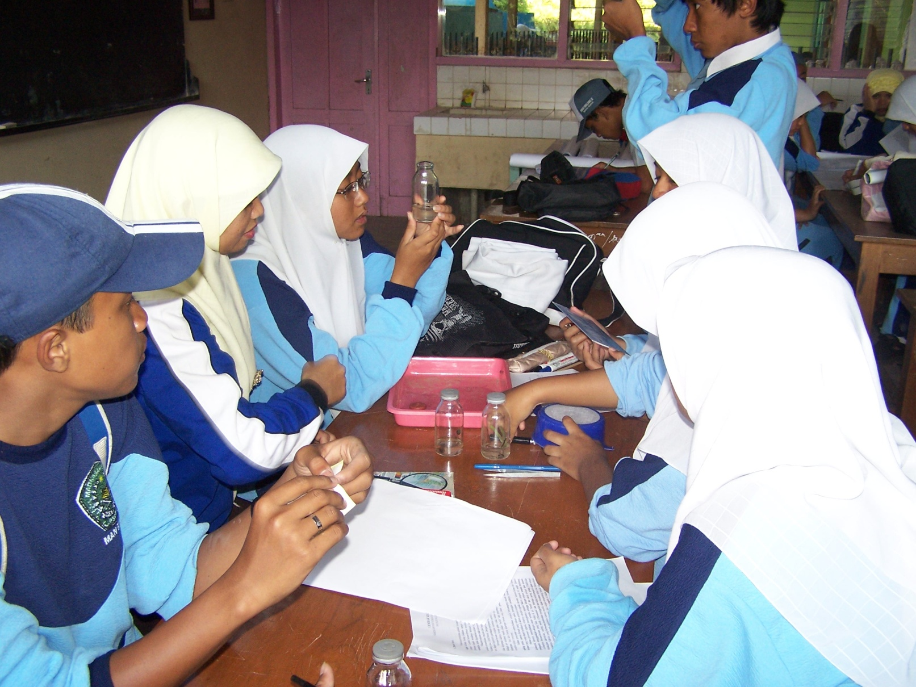
II. Brantas RB during Develoment Era
2.2. CD of Brantas Project
(6/8)
(2). Strong Leadership
Prof. Ir. Suryono, the first general manager of Brantas Project, introduced innovative management system through trial-and-error process.
One of the millstones is introduction and consistent implementation of the “One River, One Plan and One Management” philosophy.
He has political leverage at the MPW to gain government support on the adoption of “Force Account” system in the implementation of the work.
The leadership of Prof. Ir. Suryono had been able in uniting minds & mobilizing efforts of all the employees towards the successful realization of the project.
Notes:
(2). Strong Leadership
From 1961 to 1975, Prof. Ir. Suryono, the first general manager of the Brantas Project, introduced innovative management system through trial-and-error process. One of the millstones is introduction and consistent implementation of the “One River, One Plan and One Management” philosophy.
He has political leverage at the Ministry of Public Works to get political support to adopt “Direct Force or Force Accounts” in the implementation of the project.
The leadership of Prof. Ir. Suryono had been able in uniting minds and mobilizing efforts of all the Brantas employees towards the successful realization of the project.

Slide 16
II. Brantas RB during Develoment Era
2.2. CD of Brantas Project
(7/8)
(3). Brantas Spirit
Prof. Ir. Suryono led Brantas employees to create a culture to value hard work and creative workmanship based on:
a spirit of ambition and desire to achieve the goals,
a spirit of not give up easily,
a spirit of always looking new challenges,
a spirit of openness to accept new things, varied, and challenging, to accept, give and share opinion and experiences,
a spirit to learn, responsibility, ethics, integrity, initiative, and pioneering, and
a spirit of solid team work.
This working spirit is hereinafter referred to as the “Brantas Spirit”. This spirit could be condensed as “3-Cs” – spirit: Creative, Cooperative and Confident Spirit to achieve the goal successfully (Sato H., 2001).
Notes:
(3). Brantas Spirit
Prof. Ir. Suryono led and guide the Brantas employees to create a culture to value hard work and creative workmanship based on:
spirit of ambition and desire to achieve the goals,
spirit of not give up easily,
spirit of always looking new challenges,
spirit of openness to accept new things and challenging, to accept, give and share opinion and experiences,
spirit to learn, responsibility, ethics, integrity, initiative, and pioneering, and
spirit of solid team work.
This working spirit is hereinafter referred to as the “Brantas Spirit”. The spirit of Brantas could be condensed as “3-Cs” – spirit: Creative, Cooperative and Confident Spirit to achieve the goal (the Project implementation) successfully (Sato H., 2001).

Slide 17
II. Brantas RB during Develoment Era
2.2. CD of Brantas Project
(8/8)
(4). Incentives schemes
HRD cannot be achieved unless the management offers work incentives and serious-minded responsibility.
Having authority in the governing policies of wages and salaries, Brantas Project applied the job evaluation and performance based salaries system (merit system)
The Brantas Project paid much higher salaries to its employees than those of other project offices in the country.
Notes:
(4). Incentives schemes
Human resource development cannot be achieved unless the management offers work incentives and serious-minded responsibility.
Brantas Project had authority in governing policies of wages and salaries. We applied job evaluation and performance based salaries system (merit system).
The Brantas Project paid much higher salaries to its employees than those of other project offices in the country.

Slide 18
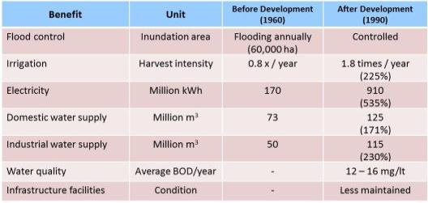
II. Brantas RB during Develoment Era
2.3. Performance of the Brantas Project
(1/3)
(a). Direct Performances
The direct project performance compose of direct project benefits such as flood control, irrigation, power generation, DMI water supply.
In 1990: flood had been controlled in main stream, W/S for irrigation, hydropower, D&I was increased by 225%, 535%, 171% and 230% respectively from those in 1960, but water quality degradation occur, less maintenance of WR infrastructures
Notes:
(a). Direct Performances
The direct project performance compose of direct project benefits or project outputs such as flood control, rice production, electricity generation, domestic and industrial water supply
Comparison could be made on situation prior to the development (1960) and after development (1990)
Summary of direct benefit resulted from WRD (1960 –1990) were:
No flood occur from main stream,
water supply for irrigation, hydropower, domestic and industries was increased by 225%, 535%, 171% and 230% respectively from those in 1960.
But, water quality degradation occur, maintenance of WR infrastructures was not well implemented

Slide 19
II. Brantas RB during Develoment Era
2.3. Performance of the Brantas Project
(2/3)
(b). Indirect Performances
The indirect project performance can be termed as region-wide and nation-wide benefits such as:
The “force account” system played a remarkable role in producing 7,000 qualified and well-trained engineers, planners, and technicians in WRD.
Quite a number of Brantas graduates had spread out all over the country and duplicated the Brantas projects successfully in different locations of the country.
In close collaboration with the Brantas Project, the Faculty of Engineering of Brawijaya University, Malang, was established in 1963
The success of the Brantas Project promoted economic growth of the region and the country. In terms of GDP, in 1993, the GDP per capita of the basin reached USD 884, while national average was USD 674.
Notes:
(b). Indirect Performances
The indirect project performance can be termed as region-wide and nation-wide benefits or project outcomes such as:
“Direct Forces - Force account” system played a remarkable role in producing about 7,000 qualified and well-trained engineers, planners, and technicians in water resources development schemes through the on the job training on the Brantas project site.
Quite a number of the Brantas graduates had spread out all over the country and duplicated the Brantas projects successfully in different locations of the country
In addition, the Faculty of Engineering of Brawijaya University in Malang City, where the Brantas Project was located, was established in 1963 in close collaboration with the Brantas Project.
The success of the Brantas Project promoted economic growth and welfare of the region as well as the country. In terms of GDP, the GDP per capita of the Brantas Basin reached USD 884 in 1993, while that of the national average was USD 674.

Slide 20
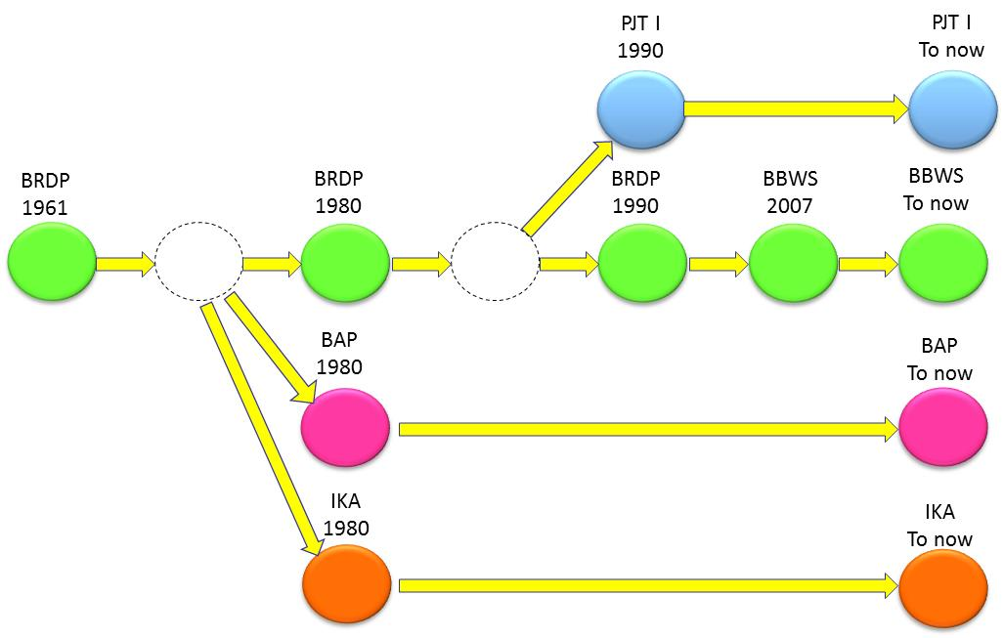
II. Brantas RB during Develoment Era
2.3. Performance of the Brantas Project
(3/3)
The Brantas Project produced a number of institutions. The organizations were spun out from the Brantas Project, namely:
In 1980:
P.T. Indra Karya (consulting company), and
P.T. Brantas Abipraya (construction company).
In 1990:
PJT I, a corporate RBO as the operator of the basin (Brantas WRM Agency)
The Brantas RB Development is said to be “the flag symbol of the successful cooperation between Japan and Indonesia on WRD”.
Notes:
In term of institutional development, the Brantas Project produced a number of institutions.
In 1980, two organizations were spun out from the Brantas Project; namely,
P.T. Indra Karya as the consulting company, and
P.T. Brantas Abipraya as the construction company.
Lastly, in 1990, Perum Jasa Tirta as a corporate RBO was established to perform O&M of water resources and its infrastructures in the basin.
These three institutions absorbed about 1,500 employees from the Brantas Project.
Those well trained Brantas-men engaged in planning, construction works and O&M of the system had been constructed.
Successful in the development of WR and in building human resources that contribute in increasing economic development and social welfares of the basin, the Brantas River Basin Development is said to be the flag symbol of the successful cooperation between Japan and Indonesia on water resources development.

Slide 21
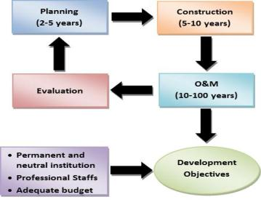
III. Brantas RB during Management Era
3.1. Jasa Tirta I Public Corporation
(1/4)
Construction phase aims to realize physical infrastructures as a means to realize the intended benefits.
After construction, it had to deal with a period to achieve the objectives of the project. It is the period of O&M of the infrastructures.
After almost 30 years period of constructions (1960 – 1990) in the era of WR Development, Brantas River Basin encountered specific problems: no institutional perform O&M, not sufficient financial sources for O&M and degradation of WR infrastructures.
To realize the development objectives, it needs permanent and neutral institution supported by professional staffs and adequate sustainable budget to perform effective O&M of the systems
Notes:
Construction phase aims to realize physical infrastructures as a means to realize the intended benefits.
After construction, it had to deal with period of Operation and Maintenance (O&M) to achieve the objectives. It is the longest period of the cycle (50-100 years).
Adequate O&M activities are necessary to be performed to maintain the function of the infrastructures and to ensure optimum benefit at their planned lifetime.
After almost 30 years period of constructions (1960 – 1990), the Brantas River Basin encountered specific problems as follows:
Institution: Until 1990, Brantas RB has no permanent institution to perform O&M activities in sustainable manner.
Funding: Brantas Project who carry out the O&M, encountered problems in obtaining fund for these activities due to the limited National Government Budget.
WR Infrastructures degradation: Lack of O&M resulted in degradation of the WR infrastructures, and less coordination among related agencies complicated the WRM.
To realize the development objectives, it needs permanent and neutral institution supported by professional staffs and adequate and sustainable budget to perform effective O&M of the systems.

Slide 22
III. Brantas RB during Management Era
3.1. Jasa Tirta I Public Corporation
(2/4)
Legal basic of PJT I establishment: GR No. 5/1990 replaced by GR 93/1999 newly updated by GR 46/2010
PJT I is a corporate typed RBO having tasks and responsibilities to:
conduct business on water resources in the basins, and
conduct part of the tasks and responsibilities of the Government on WRM in Brantas RB and Bg. Solo RB
PJT I is authorized to collect, receive and use the revenue from WSF to finance all tasks & responsibilities:
Funding sources for WRM: (i) government budget; (ii) private budget; and (iii) WRM services fee (WSF) (Law No. 11/1974 & GR No. 6/1981; replaced by Law No. 7/2004 & GR No. 46/2010);
WSF is levied for business activities, i.e. domestic and industry water supply, and hydroelectric power generation (irrigations, the biggest water users, are exempted to pay WSF).
Notes:
a. Legal basic of establishment
After a long study, the GoI got the decision to establish a pilot of corporatization on WRM, i.e. WR that be managed by a neutral and professional institution who apply in balance between prime services principle and healthy corporate norms supported by the stakeholders.
Jasa Tirta PC was then established based on the GR No. 5/1990. This regulation was replaced by the GR No. 93/1999 to strengthen the organization and permit its jurisdiction to extend to other basins. The GR No. 93/1999 was recently replaced by the GR No. 46/2010 to suit the implementation of Law No 7 of 2004 on WR and to support development of businesses on the drinking water supply and electric power generation.
b. Tasks and Responsibilities
Based on the GR No. 46/2010, the tasks and responsibilities of PJT I are related to conducting business on water resources by providing guarantee of services on water service delivery to the users AND conducting part of tasks and responsibilities of the Government on WRM in maintaining the sustainability of WR and its infrastructures.
c. Financing and Funding
Law No.11/1974 that was replaced by the Law No. 7/2004 on WR mandating that funding source for WRM can be derived from: (i) government budget; (ii) private budget; and (iii) Income from WRM services fee (water service fee – WSF). Based on the GR No. 6/1981 and GR No 46/2010,
PJT I is given authority to collect, receive and use the revenue from WSF to finance all activities related to their tasks and responsibilities.
WSF is levied for business activities, i.e. domestic and industry water supply, and hydroelectric power generation . Irrigations as the biggest water users, are exempted to pay WSF.

Slide 23
III. Brantas RB during Management Era
3.1. Jasa Tirta I Public Corporation
(3/4)
Under the Law No. 11/1974 replaced by Law No. 7/2004 on Water Resources, the Indonesia Government has enacted 2 (two) types of RBOs:
Public Utility RBO: It is government body, placed under supervision of the government, strong legitimacy, managed and staffed by government employees (30 RBOs - Central Government and 50 RBOs - Provincial Government).
Corporate RBO: It is a RBO in form of corporation owned by the Government to implement part of the Government responsible in WRDM. Responsible to the Government for its activities but otherwise operating as an independent and financially autonomous legal entity (2 RBOs: PJT-I and PJT-II).
Some of Public Utility RBOs are prepared to “quasi typed Corporate RBOs”. If in future, the financial aspect improves, they will be transformed into corporate RBOs.
Notes:
Based on Law No. 11/1974 replaced by the Law No. 7/2004 on WR, we have 2 (two) types of RBO.
Public Utility RBO: it is an integrated part of the government system. It is placed under direct supervision of the government, has a strong legitimacy, managed and staffed by government employees. 30 RBOs under Central Government and 50 RBOs are under Provincial Government.
Corporate RBO: it is a RBO in form of corporation owned by the Government and implement part of the Government responsible in WRDM. They responsible to the Government on their activities, but otherwise operating as an independent and financially autonomous legal entity guided by policies and guidelines from the Government.
The Government has intention to prepare some of Public Utility Typed RBOs to be “quasi typed Corporate RBOs”. If in future, the financial aspect of the quasi-corporate RBO improves, they will be transformed into corporate-type RBOs.

Slide 24
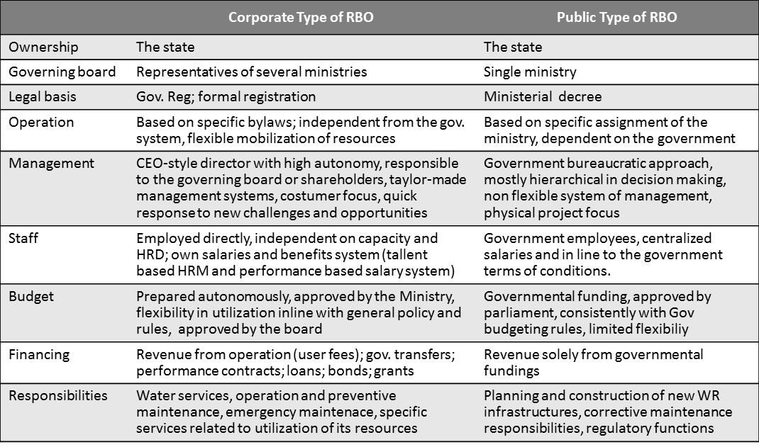
III. Brantas RB during Management Era
3.1. Jasa Tirta I Public Corporation
(4/4)
Notes:
This table show a comparison between Corporate Type RBO and Public Utility Type RBO.
The corporate RBO has a particular benefits compared with Public Utility Type RBO in term of:
flexible mobilization of resources,
quick response to new challenges and opportunities,
free to implement its own tailor-made management system, and
free to implement required capacity development and human resources development.

Slide 25
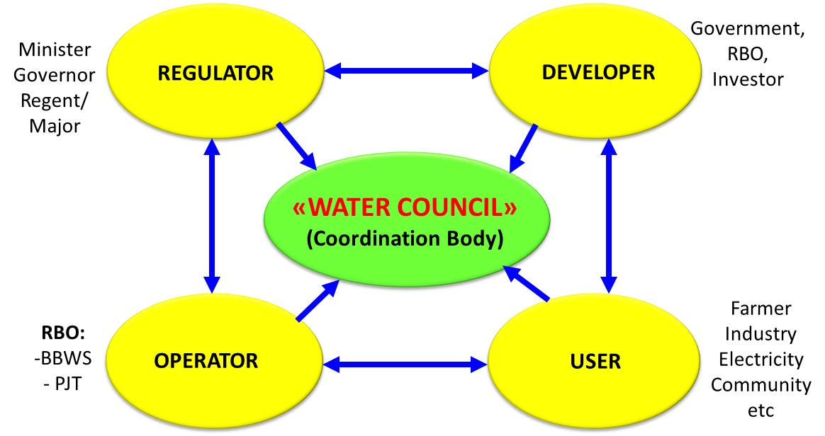
III. Brantas RB during Management Era
3.2. WRM Implementation in the RB
(1/9)
WRM Coordination Team
Legal basic
MPW Decree No. 248/KPTS/M/2009
9 February 2009
Note: WRMCT replaced Provincial WRM Committee (Panitia Tata Pengaturan Air/PTPA) that was established based on the East Java Governor’s Decree No. 59/ 1994
Organization Structure
Chairman and Vice Chairman,
Secretariat and Members,
4 Commissions:1) WR Utilization, 2) WR Conservation, 3) WR Hazard, and 4) Institution and Information System
Membership
22 – Government Org. (incl. PJT I)
22 – Non Government Org. (incl. Rep. of user’s associations)
Notes:
WRM requires a coordination and consultative mechanism to integrate the interests of various sector, territory and stakeholders in water-related basin-level development and management.
To facilitate these coordination and consultative process, a Provincial WRM Committee was established based on the Governor’s Decree No. 59/1994. The members of the Committee mainly came from the Government Instructions. Representatives of water users and community were very limited (4 members of 26 total members).
According Law No.7 Year 2004 on Water Resources, a coordination team called the Brantas Basin WRM Coordination Team – BWRMCT was established based on MPW Decree No. 248/KPTS/M/2009. This Coordination Team replaces the functions of PTPA.
Total members of BWRMCT are 44 (forty four) members. It compost 22 (twenty two) members from Government Organizations and the other 22 (twenty two) members from NGOs. The Coordination Team consists of Chairman, Vice Chairman, Secretary and Members. The Team is supported by Secretariat and 4 (four) Commissions, namely Commissions on Water Resources Utilization, Commissions on Conservation, Commissions on Water Hazard, and Commissions on Institution and Information System.

Slide 26
III. Brantas RB during Management Era
3.2. WRM Implementation in the RB
(2/9)
The WRM functions adopted by PJT I includes 6 aspects of WRM:
catchment management,
water quantity management,
water quality management,
flood management,
river environment management, and
O&M of Infrastructures.
It is supported by:
river basin planning,
information management (data networks and communication), and
public involvement and awareness campaign.
Notes:
The WRM functions adopted by PJT I includes 6 aspects of WRM, i.e:
catchment management,
water quantity management,
water quality management,
flood management,
river environment management, and
Operation & Maintenance of Infrastructures.
It is supported by cross cutting functions includes:
river basin planning,
information management (data networks and communication), and
public involvement and awareness campaign.
Some of these functions are not in PJT I tasks and responsibilities. In the following slides I will share on PJT I CD strategies programs to improve the capacity to gain trusted technical competencies and to place strategic roles of PJT I in participatory process of IWRM in the basin.

Slide 27
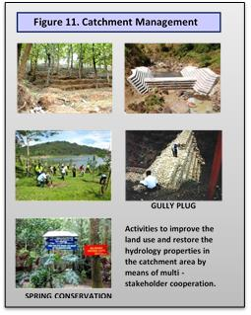
III. Brantas RB during Management Era
3.2. WRM Implementation in the RB
(3/9)
Catchment conservation are ultimately responsibility of the Ministry of Forestry, the Ministry of Agriculture and Local Government (Provincial and District Governments). PJT I has proactive collaboration in erosion, sedimentation control and catchment conservation activities.
If the unit cost of sediment controlled is smaller than the unit cost of reservoir dredging done by PJT I, PJT I share the cost of construction of sediment control structures .
Supported by the Ministry of SoC, PJT I and other 7 SoCs established a subsidiary company named “Bhakti Usaha Menanam Nusantara – Hijau Lestari II” (BUMN-HL2).
BUMN-HL2 mission is to develop “community-forest” collaborate with the communities based on eco-business approach.
Catchment Management
Notes:
Catchment conservation are ultimately responsibility of the Ministry of Forestry, the Ministry of Agriculture and Local Government (Provincial and District Governments). PJT I has proactive collaboration with communities and District Governments in erosion, sedimentation control and catchment conservation activities.
PJT I will share the cost of construction of sediment control structures if the unit cost of sediment controlled is smaller than the unit cost of reservoir dredging done by PJT I. The structures were constructed by local people supervised by the Technical Implementing Unit of District Government. In 2010 up to 2012, more than 200 sediment control structures were built.
As commitment on the issues of global warming, the President of the Republic of Indonesia launched the Indonesian Movement on One Billion Trees Planting in 2010 in order to realize 30% of Java Island becomes good forest area to improve sustainability of catchment function.
The Government asks private sectors to participate in this program. PJT I invite other SoCs to participate in Brantas and Bengawan Solo Catchment Rescue Program. Supported by the Ministry of SoC, PJT I and other 7 SoCs established a subsidiary company named “Bhakti Usaha Menanam Nusantara – Hijau Lestari II” (BUMN-HL2).
This subsidiary company’s mission is to develop “community-forest” collaborate with the communities based on eco-business approach. BUMN-HL2 has eco-business agreements with group of farmers. The farmers share their lands and BUMNHL2 share the cost of investment and production.
In 3 (three) years operation, BUMN-HL2 carry out re-greening of 1,626,000 trees planting, covering 2,735 ha of community land involving 3,792 farmers. The trees planted in 2002 – 2012 by PJT I and BUMN-HL2 was about 3.1 million trees.

Slide 28
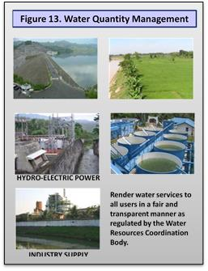
III. Brantas RB during Management Era
3.2. WRM Implementation in the RB
(4/9)
PJT I prepare water allocation plan to be discussed with and to be approved by the stakeholders in WRMCT. PJT I operate the WR infrastructures in order to distribute water according to the agreed allocation plan;
PJT I utilizes telemetry facilities as near real time monitoring to control the distribution.
In drought condition, PJT I conduct cloud seeding to generate artificial rain after getting approval from the Governor based on recommendation from WRMCT.
Advisory visit to the users and related agency are conducted periodically to get their inputs and their perception on service delivery from the corporation.
Stakeholders satisfaction survey is done yearly to gauge the level of stakeholders satisfaction.
Water Quantity Management
Notes:
Water quantity management consists of water allocation and distribution.
PJT I prepare water allocation plan to be discussed with and approved by the stakeholders in WRM Coordination Team (WRMCT). PJT I operate the WR infrastructures in order to distribute water according to the agreed allocation plan. The corporation utilizes telemetry facilities as near real time monitoring system to control the distribution.
To mitigate drought condition, PJT I and the Agency for Assessment and Application of Technology conduct cloud seeding to generate artificial rain after getting approval from the Governor based on recommendation from WRMCT.
Advisory visit to the users and related agency are conducted periodically to get their inputs and their perception on service delivery from the corporation. Result of this visit is used to improve the delivery service system.
Stakeholders satisfaction survey (done every year) shows that the stakeholders, in general, satisfy on the PJT I services in water allocation and distribution.
External acknowledgement: “PJT I has achieved results in implementing a reasonably good system of water allocation and management and a reliable flood forecasting system, as well as maintaining major infrastructure in fairly good condition (Bhat et al. May 2005)

Slide 29
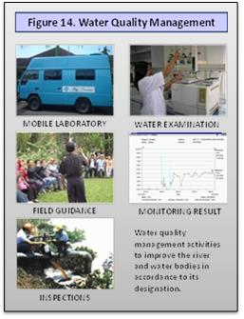
III. Brantas RB during Management Era
3.2. WRM Implementation in the RB
(5/9)
Water pollution control responsibility lies with the governor . The Governor delegate responsibility to the Head of the Provincial Environmental Agency who coordinates all other agencies dealing with water quality management and water pollution control.
PJT I responsible in monitoring, evaluating, reporting and giving recommendation on water quality status, and water pollution; and prepare technical recommendation for the approval of effluent discharge licenses.
PJT I has to equip themselves with water quality telemetry and laboratory facilities. In 2004, water quality telemetry system was installed. Accredited ISO 17025 of Water Quality Laboratory had been constructed in Malang and Mojokerto.
Water Quanlity Management
Notes:
Water pollution control responsibility lies with the governor in accordance with GR No. 20/1990 on Water Pollution Control. The Governor delegate responsibility to the Head of the Provincial Environmental Agency. This agency coordinates all other agencies dealing with water quality management and water pollution control.
PJT I is responsible in monitoring, evaluating, reporting and give recommendation on water quality status, and water pollution in the river system; and prepare technical recommendation for the approval of effluent discharge licenses.
To do these responsibilities, PJT I have to equip themselves with water quality telemetry and laboratory facilities. In 2004, water quality telemetry system was installed includes 23 (twenty three) online water quality monitoring stations and 14 (fourteen) hydrological and water level monitoring stations. Accredited ISO 17025 of Water Quality Laboratory had been constructed in Malang and Mojokerto.
Water quality telemetry system send alert to PJT I Head Office and Provincial Environmental Agency whenever the water quality in the river system is below predefined values (DO parameter). The Provincial Environmental Agency will take immediate action in collecting data and information to determine the pollution sources for further investigation and law enforcement.

Slide 30
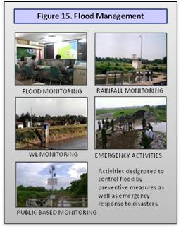
III. Brantas RB during Management Era
3.2. WRM Implementation in the RB
(6/9)
PJT I undertake FC by operating the WR infrastructures based on the evaluation result of hydrological data accumulated by telemetry facilities, the “heart” and key component in FC and water distribution.
Information concerning river conditions and the alerts is disseminated to related institutions and people along the river based on a predefined mechanism.
Maintain the function of the equipment has to be carried out properly in order to have reliable facilities. PJT I technicians has developed their capability to maintain and repair the system.
In communities that has not yet covered by early warning from telemetry facilities, PJT I has develop simple facility of Community Based Early Warning System (CBEWS)
Flood Management
Notes:
PJT I undertake flood control by operating the WR infrastructures based on the evaluation result of hydrological data accumulated by telemetry facilities. This telemetry facility was installed in 1989. It is the “heart” and key component in flood control and water distribution. Baseline data are stored in the dBase of the system and utilized to forecast the flood and water distribution.
Information concerning river conditions and the alerts at every stage of flood is disseminated to the related institutions and people living along the river through the related government agencies based on a predefined mechanism.
Maintain the function of the equipment has to be carried out properly in order to have reliable facilities. Due to “obsolete technology” utilized (25 years old), it is sometimes difficult to find spare parts due to discontinued production. PJT I technicians has developed their capability to maintain and repair the system. Nowadays, PJT I capable to develop, install and maintain complete telemetry system using local available product and technologies.
In communities that has not yet covered by early warning from telemetry facilities, PJT I has develop simple facility of Community Based Early Warning System (CBEWS) to strengthened local capabilities in making timely and accurate decisions for the protection of their lives and property.
External acknowledgement: “……….. flood management has improved and can be seen as one of the achievements of the past decade….”(Bhat et al., 2005)

Slide 31
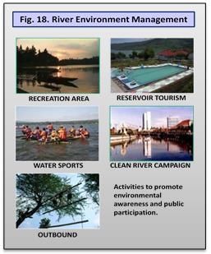
III. Brantas RB during Management Era
3.2. WRM Implementation in the RB
(7/9)
River Env. Management
River Corridor Management is an effort of controlling river corridor land use to keep the function of the river system.
PJT I participate in River Environment Land Use Management by preparing land use patterns based on both local and regional spatial planning.
PJT I had also develop some area for river tourism to invite peoples enjoy the river and its surrounding. This strategy aimed to build people awareness to keep clean, healthy and function of the river system.
Notes:
River Corridor Management is an effort of controlling river corridor land use to keep the function of the river system.
PJT I participate in River Environment Land Use Management by preparing land use patterns based on both local and regional spatial planning.
PJT I had also develop some area for river tourism to invite peoples enjoy the river and its surrounding. This strategy aimed to build people awareness to keep clean, healthy and function of the river system.

Slide 32
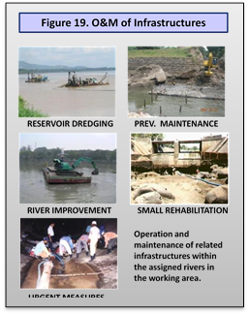
III. Brantas RB during Management Era
3.2. WRM Implementation in the RB
(8/9)
O&M activities are the main activities during the post development of the infrastructures
Operation (O) is an attempt to control and distribute water in order to achieve optimum utilization and minimize negative impacts such as flood and drought.
Maintenance (M) is an attempt to secure sustainability of WR infrastructures
Maintenance activity consists of:
Preventive Maintenance;
corrective maintenance; and
emergency maintenance.
Preventive Maintenace (PM) is the most important aspect in infrastructure management. When done properly, PM could avoid further damage that will require a big amount of repair cost as well as potential disrupt bulk water delivery and flood control.
River Env. Management
Notes:
In WRM, O&M activities are the main activities during the post development of the infrastructures
Operation (O) is an attempt to control and allocate water and its resources in order to achieve optimum utilization according to the purpose and minimize negative impacts such as flood and drought.
Maintenance (M) is an attempt to secure sustainability of water resources, its infrastructure and the environment itself.
Maintenance activity consists of preventive, corrective and emergency maintenance. Preventive Maintenance is in form of routine maintenance, periodical maintenance and small repair to prevent from serious damage; corrective maintenance in forms of large-scale repair, rehabilitation, rectification and special maintenance in the frame of restoring/ increasing the capacity of the water resources infrastructure; and emergency maintenance is a temporary repair due to emergency condition (like floods).
Preventive maintenance (PM) is the most important aspect in infrastructure management. When done properly, PM could avoid further damage that will require a big amount of repair cost as well as potential disrupt bulk water delivery and flood control. The corporation put proper implementation of PM as the highest priority tasks.

Slide 33
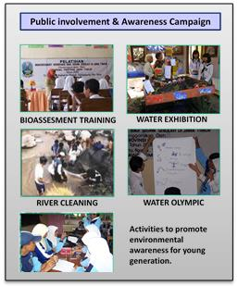
III. Brantas RB during Management Era
3.2. WRM Implementation in the RB
(9/9)
Public Participation
Youth awareness
In collaboration with Malang State University and some Senior High Schools, PJT I established WQ Monitoring Communication Networks in 1997;
Objectives: to raise awareness of the students by developing extra curricula activities to:
introduce issues, challenges and problem solving related to WRM & environment in river basin;
promote field activities of the students ; and
share knowledge and experiences among members
Members: 112 Senior High Schools.
River Lovers Communities
PJT I and local Government promote and facilitate the establishment of “Jogo Tanggul” groups (Levee Safeguarding Group). Proactive participation of the communities to safeguarding the levees and other river infrastructures.
Notes:
To promote awareness of young generation, in 1997, PJT-I established Jaring-Jaring Komunikasi Pemantauan Kualitas Air, JKPKA (Communication Networks on Water Quality Monitoring) in cooperation with State University of Malang and teachers from senior high schools along the Brantas River. Total “founding – members” was 26 Senior High Schools.
The objective of this communication networks is to raise awareness of the students on water resources, river and environment by developing extra curricula activities.
After 15 years of establishment, the member of JKPKA is 112 (one hundred twelve) Senior High Schools (including Bengawan Solo RB). Nowadays, some river basins have established the JKPKA.
PJT I promote and facilitate the establishment of “Jogo Tanggul” groups (Levee Safeguarding Group). It is proactive and positive participation of the communities surrounding the river to safeguarding the levees and other river infrastructures.

Slide 34
III. Brantas RB during Management Era
3.3. Capacity Development of PJT I
(1/12)
The Challenges & the Strategic CD Programs
Financial sources to implement the tasks & responsibilities is from the payment of WSF from their commercial water users.
Needs to change their culture from bureaucrat to entrepreneur, from being spending money to looking money.
The sustainability of PJT I (common goal) depend on the Gov. trust, customer willingness to pay, successful of cultural transformation.
Some strategic programs had been formulated:
Formulate the corporate vision and define the key success area;
Develop and implement the appropriate management system;
Strengthen their competences in WRM and in corporate mng;
Generate sustainable source of funding.
These main strategies should be supported by:
Government political support and legal frameworks;
Strong leadership, appropriate spirit and culture;
Effective incentive scheme.
Notes:
Jasa Tirta I (PJT I) is a corporate type RBO who receive mandate from the Gov. to implement part of the government tasks and responsibilities on WRM in Brantas and Bengawan Solo RB. The main financial sources for PJT I to implement the tasks and responsibilities is from the payment of WSF from their commercial water users.
PJT I in the first 5 years of its establishment faced a new and delicate challenges. Most of the key staffs came from Brantas Project. It needs to change their culture from bureaucrat to entrepreneur, from being spending money to looking money for implementing the tasks and responsibilities.
The sustainability of PJT I is our common goal. It depend on the Government trust and on customer willingness to pay as well as the success of cultural transformation. To achieve our common goal, some strategic programs had been formulated:
Formulate the corporate vision and define the key success area;
Develop and implement consistently the appropriate management system;
Strengthen technical & management competences in WRM and in corporate mng;
Generate sustainable source of funding and effective, efficient and accountable utilization of the funds to perform the tasks and responsibilities.
These main strategies should be supported by:
Government political support and legal frameworks;
Strong leadership, appropriate spirit and culture;
Effective incentive scheme.

Slide 35
III. Brantas RB during Management Era
3.3. Capacity Development of PJT I
(2/12)
(a). Vision as long term guiding perspective
In 1993, PJT I prepare the Vision of 2020.
It comprised stages of PJT I development and policy directives:
1st 10 years (1991-2000) is Consolidating and Positioning Stages,
2nd 10 years (2001-2010) is the 1st Development Stages, and
3rd 10 years (2011-2020) is the 2nd Development Stages.
Based on the current conditions and challenges, in 2010, PJT I formulate the Vision of 2025: “to be one of the best RBO in Asia Pacific by 2025”. PJT I has to be as a Benchmarked RBO.
It is challenging vision but we believe it is attainable. This vision was resulted from serial discussions and communication. A bottom up participatory process to build the ownership.
This vision is deemed to be in line with our common goal to maintain the sustainability of the organization..
Notes:
In 1993, PJT I prepare the Vision of 2020. It comprised stages of PJT I development and policy directives.
The 1st 10 years (1991-2000) is Consolidating and Positioning Stages,
The 2nd 10 years (2001-2010) is the 1st Development Stages, and
The 3rd 10 years (2011-2020) is the 2nd Development Stages.
Based on the current conditions and challenges, in 2010, PJT I formulate the Vision of 2025: “to be one of the best RBO in Asia Pacific by 2025”.
PJT I has to be as a Benchmarked RBO, a RBO to be referred to.
It is challenging vision but we believe it is attainable.
This vision was resulted from serial discussions and communication. It was bottom up participatory process to build the ownership.
This vision is deemed to be in line with our common goal to maintain the sustainability of the organization..

Slide 36
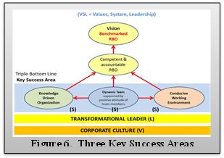
III. Brantas RB during Management Era
3.3. Capacity Development of PJT I
(3/12)
(b). Triple Bottom Lines of Key Success Area
To be as a Benchmarked RBO, PJT I has to be a competent and accountable RBO, having high performance in WRM and in Corporate Management, and to be one step ahead from the other.
PJt I formulate 3 - Key Success Areas:
Knowledge driven organization,
The Winning Team, and
Conducive working condition.
(1). Knowledge Driven Organization
Acquisition, development and maintenance of knowledge are a cross-cutting task of the RBO, in pursuit of its performance.
PJT I's motto: “Growing to lead" (to be always one step ahead from the others).
Notes:
Triple Bottom Lines of Key Success Areas:
To be as a Benchmarked RBO, PJT I has to be:
a competent and accountable RBO,
having high performance in WRM and Corporate Management, and
to be one step ahead from the other.
PJt I formulate 3 (three) Key Success Areas to achieve the vision.
(1). Knowledge Driven Organization
Acquisition, development and maintenance of knowledge are a cross-cutting task of the RBO, in pursuit of its performance.
The knowledge-driven RBO characterize by:
has a knowledge-based corporate culture;
produces knowledge based products and services;
optimizes the intellectual modalities of the organization;
is a learning organization; and
adopts knowledge developed in its business processes and service delivery.
PJT I's has a motto in this key success area: “Growing to lead" (try to be always one step ahead from the others).

Slide 37
III. Brantas RB during Management Era
3.3. Capacity Development of PJT I
(4/12)
(2). The Winning Team
The leader and the team should be mobilized and synergized to contribute positively their thinking, feelings and eagerness to move forward together as an assembly of symphony.
Solid and dynamic team is the main heart and prerequisite to achieve the organization’s goals.
PJT I's motto:“Berpadu Daya, Bersatu Karsa, Gapai Cita Bersama” (Unity of our forces and strong eagerness to achieve our goals).
(3). Conducive Working Condition
A supportive corporate working condition is needed for continuous improvement and to guarantee the quality of products and services.
It is the enabling factors to promote better performances.
Notes:
(2). The Winning Team
The leader and the team should be mobilized and synergized to contribute positively their thinking, feelings and eagerness to move forward together as an assembly of symphony from planning, implementation, monitoring & corrective actions.
Solid and dynamic team is the main heart and prerequisite to achieve the organization’s goals. It is requires:
loyalties, ownership, and pride to be part of the organization;
positive attitudes of each individual team member; and
spirit of openness, willingness to learn, share the experiences and spirit of solid team work.
PJT I's motto:“Berpadu Daya, Bersatu Karsa, Gapai Cita Bersama” (Unity of our forces and strong eagerness to achieve our goals).
(3). Conducive Working Conditions
A supportive corporate working condition is needed for continuous improvement and to guarantee the quality of products and services.
It is the enabling factors to promote better performances. This involve, among others:
clear and documented policies and minimizing the occurrence of decisions that are inconsistent with corporate written rules and policies;
open management, providing anyone with opportunities to share their views and ideas;
incentives for innovation, revenue and profit achievement;
performance-based salaries system (merit system)

Slide 38
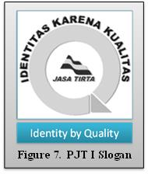
III. Brantas RB during Management Era
3.3. Capacity Development of PJT I
(5/12)
(c). Quality Management System
PJT I adopt ISO-9000 based QMS to help in building the organization culture of continues performance improvement and responsive actions on stakeholder’s complaints.
In 1997, PJT I received international certification of ISO 9001 in Design, Operation and Maintenance of WR and Infrastructures issued by The SGS ICS.
Benefits of quality management are as follows:
operational aspect is not affected by change of the employed workforce;
main tasks are undertaken more efficient and effectively;
stakeholders’ complaints are better handled and anticipated;
better relationship between stakeholders and beneficiaries;
improvement in the company’s performance;
achieve stakeholders satisfaction; and
gain Government trust to be National wide RBO.
Notes:
(c). Quality Management System
PJT I adopt ISO-9000 based QMS to help in building the organization and individual culture of continues performance improvement and responsive actions on stakeholder’s complaints to gain government trust and stakeholder’s satisfaction.
In 1997, PJT I received international certification of ISO 9001 in Design, Operation and Maintenance of WR and Infrastructures issued by The SGS ICS.
PJT I motto on QMS is: Identity by Quality
The experience is clearly positive. A well-documented, transparent and predictable operation has generated improved performance and higher stakeholder satisfaction.
Benefits of quality management are as follows:
operational aspect is not affected by change of the employed workforce;
main tasks are undertaken more efficient and effectively;
stakeholders’ complaints are better handled and anticipated;
better relationship between stakeholders and beneficiaries;
improvement in the company’s performance;
achieve stakeholders satisfaction; and
gain Government trust to be National wide RBO.

Slide 39
III. Brantas RB during Management Era
3.3. Capacity Development of PJT I
(6/12)
(d). Technical and managerial competences
Successful performance of an organization large depend on the quality of its HR. PJT I implement 3 (three) strategies for HRD:
(1). Education and Training
Formal education at university in abroad and in the country. Training in national and international education centers as well as in-house training.
(2). Networking and knowledge sharing
active participation in the networking and in the professional association.. PJT I is member of NARBO, INBO, ICID, INACOLD, HATHI, MHI etc.
active participation in seminar-workshop (national and international level)
twinning programs with other RBO to exchange staffs.
periodical knowledge sharing to discuss, share opinions in a specific issues
(3). Focus Group Discussions
Establish FGD to discuss on specifics issues (manuals, SOPs, applied technologies etc.)
Notes:
(d). Technical and managerial competences
HR is the most crucial asset of an organization. The successful performance of an organization large depend on the quality of its HR. To improve technical and management quality of the organization’s HR, PJT I implement 3 (three) strategies:
(1). Education and Training
Formal education at university in abroad and in the country. Training in national and international education centers as well as in-house training.
(2). Networking and knowledge sharing
Networks, professional associations and information technologies are now becoming powerful tools of CD.
active participation in the networking and in the professional association.. Nowadays, PJT I is member of NARBO, INBO, ICID, INACOLD, HATHI, MHI etc.
active participation in many seminar-workshop at national and international level
twinning programs with other RBO to exchange staffs,
periodical knowledge sharing to discuss and share opinions in a specific issues
(3). Focus Group Discussions
PJT I establish FGD to discuss in detail some specifics issues (manuals, SOPs, applied technologies etc.)

Slide 40
III. Brantas RB during Management Era
3.3. Capacity Development of PJT I
(7/12)
(e). Sustainable Financial Sources
Based on the principle of cost recovery (CR)
Budget sources:
Government budget (Government Obligation Principle);
private budget (PPP principle), and
revenue from WSF (Beneficiaries Pay Principle).
Beneficiaries must bear the WSF (except for daily basic needs & irrigation)
Stepwise implementation of WSF: O&M CR → Investment CR
Tariff determination: acceptability policy (fair, transparent, participative)
Cross subsidy, incentive and disincentive, and tariff uniformity
Transparence and accountable of utilisation
From water back to water (Earmarked Fund)
Flexibility of fund use
Notes:
The Law No 7 of 2004 on WR and the GR No 42 of 2008 on WRM provide policy framework for financing of WRM in Indonesia.
To ensure the sustainable benefits of water resources and its infrastructure, the funds for WRM need to be adequately provided based on the principle of cost recovery, which includes costs for O&M and investment CR.
The funds for WRM can be from the Government budget (based on Government Obligation Principle); private budget (Public Private Partnership Principle) and revenue from WRM service fee or simple Water Service Fee (WSF)(based on Beneficiaries Pay Principle).
For those who receive benefits from WRM except users of water resources to meet their daily basic needs and irrigation, must bear the WSF. The revenue from WSF shall be used to support financing for WRM (ear marked fund principle).
Basic policies for WSF implementation consist of gradual steps of the implementation, flexibility of fund uses, earmarked fund, cross subsidy, incentive and disincentive, tariff uniformity and water conservation.

Slide 41
III. Brantas RB during Management Era
3.3. Capacity Development of PJT I
(8/12)
Revenue Generation in PJT I:
Water Resources Business: WSF charged to commercial users for raw water services (Domestic Water Supply Companies, Industries and Electricity Company).
Non Water Resources Business: covers all forms of services other than water service delivery obtained from optimization of the utilization of assets owned or controlled by the company.
Water sports and tourism services
Construction and equipment rental services
Consulting services
Water quality laboratory services
Eco business/Agro forestry activities
Drinking water supply system
Hydro electric power plant
Education and training
etc
Notes:
Revenue of PJT I comes from:
Water Resources Business: main source of budget to implement the tasks and responsibilities are from the payment of WSF charged to commercial users such as: Domestic Water Supply Companies, Industries and Electricity Company.
Non Water Resources Business: covers all forms of services other than water service delivery obtained from optimization of the utilization of assets owned or controlled by the company.
Water sports and tourism services
Construction and equipment rental services
Consulting services
Water quality laboratory services
Eco business/Agro forestry activities
Drinking water supply system
Hydro electric power plant
Education and training
etc

Slide 42
III. Brantas RB during Management Era
3.3. Capacity Development of PJT I
(9/12)
(d). Driving Factors
(1). Strong Government Supports and wider Authority
Government supports continuously the successful of PJT I. Issuance of serial GRs on PJT I (GR No. 5/1990, GR No. 93/199 and GR No. 46/2010) to make favorable and strengthened PJT I. To guide PJT I’s operation , the Government issued Ministerial Decrees, Provincial Regulations and Governor Decrees as legal basic on technical guidance and implementation of PJT I’s task and responsibilities.
MPW, MSoC and Prov. Governments have representative in the Supervisory Board of PJT I to facilitate speedy and consistency of required political support decisions.
Government got political decision to put corporatization on WRM as the end goals of WRM institutions in river basin level.
The Government has intention to scaling up PJT I as National Wide Corporate RBO to manage national strategic river basins.
Notes:
(1). Strong Government Supports and wider Authority
As a pilot of corporatization in WRM, Government supports continuously the successful of PJT I. Issuing serial GRs on PJT I (GR No. 5/1990, GR No. 93/199 and GR No. 46/2010) to make favorable and strengthened PJT I. To guide technical operation of PJT I, the Government had also issued Ministerial Decrees, Provincial Regulations and Governor Decrees as legal basic on technical guidance and implementation of PJT I’s task and responsibilities.
MPW, Ministry of State Owned Company (SoC) and Provincial Governments have representative in the Supervisory Board of PJT I to facilitate speedy and consistency of required political support decisions.
After a long period of exercises, the Government got political decision to put corporatization on WRM as the end goals of WRM institutions in river basin level as stated by the Minister of Public Works in the 1st NARBO IWRM Leadership Retreat held in Malang on June 2011 which is participated by more than 30 water leaders in Asia.
The Government has intention to scaling up PJT I as National Wide Corporate RBO to manage national strategic river basins.

Slide 43
III. Brantas RB during Management Era
3.3. Capacity Development of PJT I
(10/12)
(2). Transformational Leadership
Strong RBO leadership is among the key requirements of responsive and efficient basin-level IWRM.
RBO leaders should have great vision, thoughtful direction, the best means as well as the foresight to employ managers and staffs to carry out the improvements and lead the change.
Generating change requires transformational leaders to:
develop a new charismatic and great vision;
describe the vision;
gather support;
inspire the staff;
guide the organization;
built staff and management proud;
improve relationships between the leader and the team; and
promote motivation & confidence that “we can do it, we can solve it, we can achieve it”.
Notes:
(2). Transformational Leadership
Strong RBO leadership is among the key requirements of responsive and efficient basin-level IWRM.
RBO leaders should have great vision, thoughtful direction, the best means as well as the foresight to employ managers and staffs to carry out the improvements and lead the change that have to be done.
Generating change requires transformational leaders who can help the RBO to:
develop a new charismatic and great vision;
describe the vision in specific terms and focus areas by goals and strategies;
gather support from individuals and teams;
inspire the staff by empathetic communication;
guide the organization through a transformative phase;
built staff and management proud in working for the company and doing a good job;
improve relationships between the leader and the team, to create warmer and closer teams that feel the presence of the leader in all ways; and
promote motivation & confidence that we can do it, we can solve it, we can achieve it.

Slide 44
III. Brantas RB during Management Era
3.3. Capacity Development of PJT I
(11/12)
(3). Spirit and Corporate Culture
Brantas Spirit i.e. creative, cooperative and confidence spirit to achieve the common goal is maintain continuously in PJT I.
PJT I’s Corporate Cultures: “PINTU AIR” (the water gate culture):
P – professionalism;
I – innovation;
N – neutrality;
T – tanggap (responsive);
U – uswah (model to be referred to);
A – adil (fair and equitable services);
I – ikhlas (sincerity, honesty); and
R – rasa memiliki (ownership).
This collective behavior is the basic requirement in building continues performance improvement culture to implement the strategy and to achieve our common goals to sustain our beloved organization.
Notes:
(3) Spirit and Corporate Culture
Brantas Spirit, the spirit of creativity, spirit of cooperative and spirit of confidence to achieve our common goal is maintain continuously in the corporation and individual people of PJT I.
PJT I has incorporated the Brantas Spirit in PJT I Corporate Cultures: “PINTU AIR” (the water gate):
P – professionalism;
I – innovation;
N – neutrality;
T – tanggap (responsive);
U – uswah (model to be referred to);
A – adil (fair and equitable services);
I – ikhlas (sincerity, honesty); and
R – rasa memiliki (ownership).
These are our collective behavior as a reflection of our beliefs, values, and norms that should be maintain in the organization. This collective behavior is the basic requirement in building continues performance improvement culture to implement the strategy and to achieve our common goals to sustain our beloved organization.

Slide 45
III. Brantas RB during Management Era
3.3. Capacity Development of PJT I
(12/12)
(4). Incentives
PJT I’s incentives schemes promote innovations and spirit to get more revenue and increase cost efficiency.
Quarterly incentives:
Based on revenue achievement of each unit, the management award bonus to the staffs of those unit as percentage (80%-120%) of monthly salary → revenue achievement incentives.
End of year incentives:
Based on the achievement of corporate profit, the management award bonus to all employees about 1/3 of the excess profit → profit achievement incentives and cost efficiency incentives
Take home pay could achieve 24 months salaries/year.
Based on the experience in developing and implementing incentive schemes, it proof that appropriate incentive schemes could promote capacity development initiatives to achieve better performances.
Notes:
(4) Incentives
PJT I’s incentives schemes promote innovations and spirit to get more revenue by developing new initiatives such as reservoir operation optimization, better water services to gain costumer’s acceptability for new tariffs etc. and increase cost efficiency by introducing new technologies and improving management control and workmanship etc.
Quarterly incentives:
Based on revenue achievement of each unit, the management award bonus to the staffs of those unit as percentage (80%-120%) of monthly salary → revenue achievement incentives.
End of year incentives:
Based on the achievement of corporate profit, the management award bonus to all employees about 1/3 of the excess profit → profit achievement incentives and cost efficiency incentives
Implementation of this incentive schemes, take home pay of the employees could achieve 24 months salaries/year compared with government institution salaries is only about 13 months salaries/year.
Based on the experience in developing and implementing incentive schemes, it proof that appropriate incentive schemes could promote capacity development initiatives to achieve better performances.

Slide 46
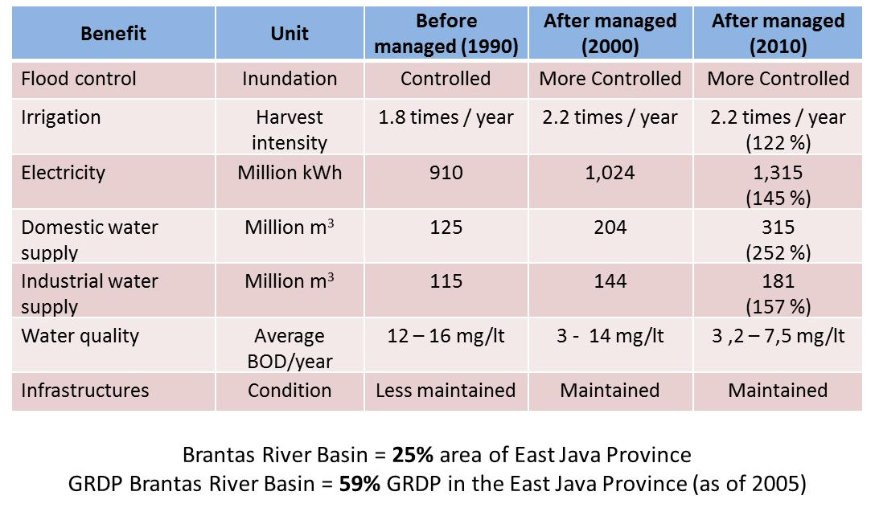
III. Brantas RB during Management Era
3.4. Performances of PJT I
(1/6)
WRM Performances
Increasing direct benefits of WRM. Comparison of direct benefit in 1990, 2000, 2010:
Flood in mainstream is managed to control 50-years return period flood.
Agricultural cropping intensity in irrigation areas guaranteed from reservoirs increase from 1.8 to 2.2 X/year.
Hydroelectric power generation is optimized from about 910 million kWh to 1,300 million kWh annually (145%).
DMI water supply increases from 240 million m³ to 500 million m³ annually (208%).
Average water quality in the basin is increasing.
The WR infrastructures mostly are in better conditions and functions.
GRDP of Brantas RB in 2003 accounted 59% of GRDP of East Java (although Brantas RB is only 25% area of East Java Province)(adopted from Statistics Central Bureau)
Notes:
a. WRM Performances
Increasing direct benefits of WRDM can be shown by comparing the direct benefit after development (in 1990, as the benchmarked year) and during management phase (2000 and 2010):
Flood in the mainstream is managed to control 50-years return period flood.
Agricultural cropping intensity in the irrigation areas guaranteed from reservoirs has increases from 1.8 to 2.2 X/year.
Hydroelectric power generation is optimized from about 910 kWh to 1,300 million kWh annually (145%).
Domestic and industrial water supply increases from 240 million m³ to 500 million m³ annually (208%).
Average water quality in the basin is increasing, although it has not yet fully achieved its target.
The WR infrastructures mostly are in better conditions and functions.
Adopted from Statistics Central Bureau, the Gross Regional Domestic Product of the Brantas RB in 2003 accounted for 59% of GRDP in East Java (although Brantas RB is only 25% area of East Java Province).

Slide 47
III. Brantas RB during Management Era
3.4. Performances of PJT I
(2/6)
Box 5. PJT I’s Performance in WRM
“Within these innovative institutional arrangements, a number of water management instruments are in place and actively being implemented PJT I have been rather successful and the Brantas basin has turned into a well-known example not only in Indonesia but also in an international context of how water resources can be more effectively is managed at the river-basin level”. (Bhat et al., 2005).
Some other performance indicators :
Better consolidated WRM system and activities
Better coordination and stakeholder’s participation in DM process
Minimize water conflict facilitated by Brantas WRMCT.
Cleaner and nicer river environment can be used for sport and tourism.
Increasing communities participation in WRM activities
Brantas RB and PJT I is recognized in national, regional and international level as a modern and dynamic RBO.
Many research and studies implemented using Brantas RB as the case study (JICA, JBIC, WB, ADB, IWMI, IFPRI, ESCAP, CapNet etc.).
Selected as one of Good Examples in UNESCO IWRM Guidelines.
One of the benchmarked RBO in NARBO.
Notes:
Some other performance indicators show that IWRM implementation is becoming:
Better consolidated of WRM system and activities supported by regional legislation for the operational basis of the management.
Better coordination, increase stakeholder’s participation in decision making process based on agreed mechanism in Brantas WRM Coordination Team.
Minimize of water conflict grace of fair and transparent reconciliation of sectoral water allocation and facilitation of Brantas WRM Coordination Tem.
Well maintained WR infrastructures and river environment in some areas had been managed cleaner and nicer which can be used for sport and tourism.
Increased public awareness and communities participation in providing social control, safeguarding the river and waterworks, pollution control etc.
Brantas RB and PJT I is recognized in national and regional as well as in international level as a modern and dynamic RBO.
Many research and studies were implemented using Brantas River Basin as the case study (JICA/JBIC, WB, ADB, IWMI, IFPRI, ESCAP, CapNet etc.).
Selected as one of Good Examples in UNESCO IWRM Guidelines at River Basin Level (UNESCO, 2010).
Selected as one of the benchmarked RBO in the Network of Asian RBO.

Slide 48
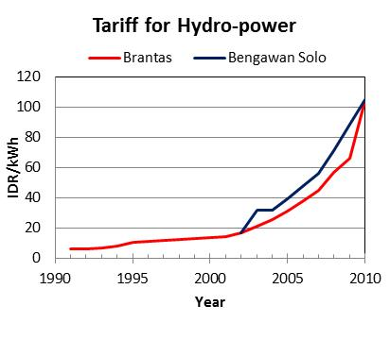
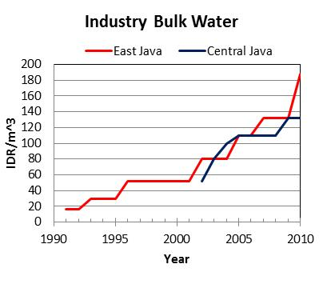
III. Brantas RB during Management Era
3.4. Performances of PJT I
(3/6)
Corporate Performances
As a state owned company, the managing corporate body subject to various management audit and control. Management performance is judged based on financial criteria’s and good-corporate performance. After 20 years of PJT I’s capacity development, some area had been achieved and should be maintain continuously:
Government got political decision to put corporatization on WRM as the end goals of WRM institutions in RB level.
The Gov. intention scaling-up PJT I to be national wide WRM body to manage national strategic RBs. The Presidential Decree No. 2/2014: PJT I manage WR in 3 other RBs.
WSF tariffs increase significant accepted by the customers. Tariff applied in 2012 was IDR. 149.37/kWh (for electricity), IDR. 112.00/m³ (for domestic W/S) and IDR. 221.07 /m³ (for industries) or increased about 10.5X, 3.2X and 4.2X respectively for those tariffs in 2001.
Notes:
b. Corporate Performances
As a state owned company, the managing corporate body is subject to various management audit and control. Management performance is judged based on financial criteria’s and good-corporate performance. After 20 years of PJT I’s capacity development, some area had been achieved and should be maintain continuously:
After a long period of exercises, the Government got political decision to put corporatization on WRM as the end goals of WRM institutions in river basin level.
Government trust to PJT I increases. The Government got the intention to scaling-up PJT I to be national wide WRM body to manage national strategic river basins. The Presidential Decree No. 2/2014 was issued as a legal basis for PJT I manage WR in 3 (three) other river basins.
Customer satisfaction increases for services rendered by PJT I. This is the key factor in accepting the WRM Service Fee tariffs. Tariff applied in 2012 was IDR. 149.37/kWh (for electricity), IDR. 112.00/m³ (for domestic W/S) and IDR. 221.07 /m³ (for industries) or increased about 10.5 times, 3.2 times and 4.2 times respectively for those tariffs in 2001.

Slide 49
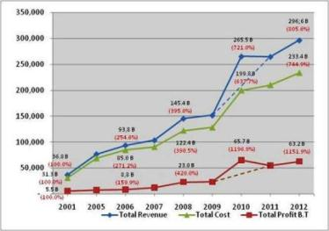
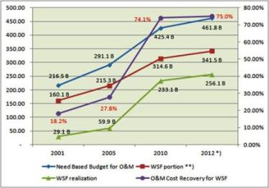
III. Brantas RB during Management Era
3.4. Performances of PJT I
(4/6)
Continues improvement culture and customer focus policy help PJT I to gain Government trust and customer satisfaction. It play an important roles in:
Significant increase of WSF revenue (8.8 X from 2001);
Significant increase of budget allocated for O&M (7.4X from 2001);
Significant improvement of O&M Cost Recovery (75 % in 2012 compared 18.2% in 2001 - just after economic crisis 1998).
Other than the WSF, PJT I also raises income from non-water business activities (consultancy, construction, tourism, and other resource utilization). Total revenue from this business is about 20% of total yearly revenue.
Notes:
Continue performance improvement culture and customer focus policy help PJT I to gain Government trust and customer satisfaction. It play an important roles in:
Increasing significantly increment on WSF revenue. It increased by 8.8 times from IDR. 29.1 Billion in 2001 to IDR. 256.1 Billion in 2012.
Budget allocated for O&M activities goes up from IDR. 27.9 Billion in 2001 to IDR. 206.8 Billion in 2012 or increased 7.4 times.
The degree of O&M Cost Recovery from WSF portion achieves about 75% compared 18.2% in 2001 (2 years after national wide economic crisis in 1998).
Other than the WSF, PJT I also raises income from non-water business activities (such as consultancy and construction services, tourism, and other resource utilization). Total revenue from this business is about 20% of total yearly revenue.

Slide 50
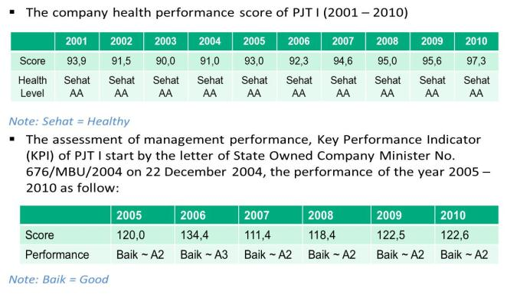
III. Brantas RB during Management Era
3.4. Performances of PJT I
(5/6)
Better corporate performance based on the assessment of external auditor assigned by MSoC (in average as a “Health AA Class and Good – A2 Class corporation).
PJT I is awarded as one of the best SoC Corporate Performance in 2012 (by Info Bank Magazine, Indonesia, Agust 2013)
Notes:
Based on the assessment of external auditor assigned by Ministry of State Owned Companies, the Company Healthy Financial Performance and Key Performance Indicator for Good Corporate Governance could be maintained as a Good Corporate Performance having “Health – AA Class” and ” Good – A2 Class” corporation.
PJT I was awarded by Info Bank Magazine, Indonesia as one of the best State Owned Company Corporate Performance in 2012

Slide 51
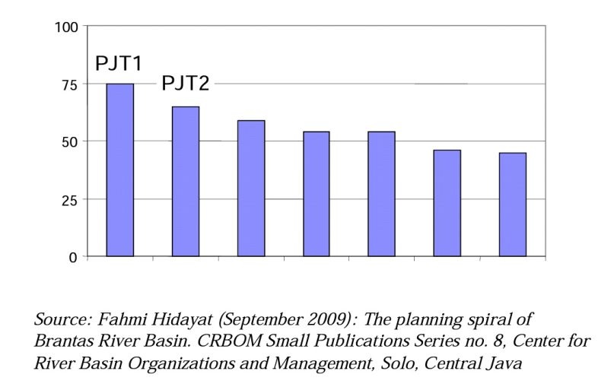
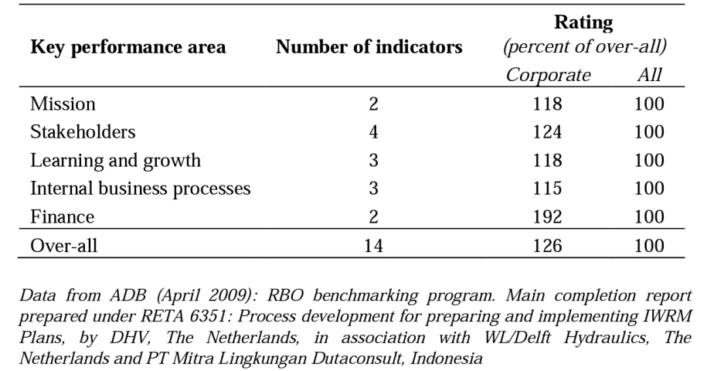
III. Brantas RB during Management Era
3.4. Performances of PJT I
(6/6)
NARBO Performance Benchmarking
NARBO’s PBM (launched on Sept. 2005) is a management tool to assist RBOs to:
Assess performance in core operational areas;
Enable peer learning on performance improvement with other RBOs;
Improve efficiency and effectiveness of service delivery; and
Track progress towards better organizational performance.
Many RBOs participate: Indonesia, Sri Lanka, Malaysia, Philippines, Thailand, and Vietnam.
In national benchmarking initiative (Indonesia, 2009), PJT I and PJT II were the best RBO among other participating organizations.
ADB RETA 6351 (2009): corporate RBOs scored above average in all key performance areas.
Notes:
NARBO RBO Performance Benchmarking:
NARBO’s Performance Benchmarking was launhed at the 2nd Southeast Asia Water Forum in Bali, Indonesia in September 2005.
It is a management tool to assist RBOs to:
Assess performance in core operational areas;
Enable peer learning on performance improvement with other RBOs;
Improve efficiency and effectiveness of service delivery; and
Track progress towards better organizational performance.
After 10 (ten) years implementation, many RBOs adopt the NARBO Performance Benchmarking: Indonesia, Sri Lanka, Philippines, Malaysia, Vietnam, Thailand.
In 2009, national benchmarking initiative in Indonesia, PJT I and PJT II was ranked as the best performance RBO among the 7 participating organizations.
Based on ADB RETA 6351, it is reported that the corporate RBOs scored above average in all key performance areas.

Slide 52
IV. Conclusions
(1/3)
Adaptive - collaborative process involving stakeholders will be the key success factor of effective IWRM implementation.
WRM Council or other name of coordination bodies should be established as a forum for coordination and consultation, for integration and synchronization of all interests in WRM.
RBO plays a strategic roles in the implementation of IWRM at a basin level. RBOs have to improve their capacity in technical competencies and in managerial capacity.
Capacity is the ability to perform functions effectively, efficiently and sustainably. Achievements of organization to do their roles and functions is depend on the ability the organization to develop and manage their capacity building;
CD is a process of transformative change. Takes place in a continuous and complex process. CD programs are more successful and more likely to be sustainable when they respond to an internal initiative.
Notes:
Adaptive - collaborative process through participatory management involving stakeholders is one of basic essence of IWRM and it will be the key success factor of effective IWRM implementation.
WRM Council or other name of coordination bodies should be established as a platform for stakeholder liaison and an advisory body, as a forum for coordination and consultation, for integration and synchronization of all interests in WRM
RBO plays a strategic roles in the implementation of IWRM at a basin level. RBOs have to improve their institutional and individual capacity, not only in technical competencies, but in managerial capacity as well.
Capacity has been defined as the ability of individuals and organizations to perform functions effectively, efficiently and sustainably. Achievements of organization to do their roles and functions is depend on the ability the organization to develop and manage their capacity building;
CD is a process of transformative change. Takes place in a continuous and complex process. CD programs are more successful and more likely to be sustainable when they respond to an internal initiative.

Slide 53
IV. Conclusions
(2/3)
Successful of CD initiatives depend on the commitment and consistency the peoples within the organization to develop, strengthen and maintain their continues performance improvement of organizational cultures.
Driving forces required in implementing CD programs consists of:
Political Government support and appropriate institutional and legal frameworks,
Strong transformational leadership to build willingness and ownership of CD programs, to build their spirits and cultures and to unify their minds and eagerness in achieving successfully their common goals.
PJT I implement their CD’s programs consistently supported by solid team works, dedicated staffs, “Brantas Spirit” (a “3-Cs” spirit: creative, cooperative and confident spirit to achieve common goals successfully) and culture of continues performance improvement.
Notes:
Successful of CD initiatives depend on the commitment and consistency of all managements and staffs of the organization to develop, strengthen and maintain their continues performance improvement of organizational cultures.
Driving forces required in implementing CD programs consists of:
Political Government support and appropriate institutional and legal frameworks,
Strong transformational leadership to build willingness and ownership of CD programs, to build their spirits and cultures and to unify their minds and eagerness in achieving successfully their common goals.
PJT I implement their CD’s programs consistently supported by solid team works, dedicated staffs, “Brantas Spirit” (a “3-Cs” spirit: creative, cooperative and confident spirit to achieve common goals successfully) and culture of continues performance improvement.
PJT I implement their strategies consistently supported by solid team works, dedicated staffs, “Brantas Spirit” (a “3-Cs” spirit: creative, cooperative and confident spirit to achieve common goals successfully) and culture of continues performance improvement.

Slide 54
IV. Conclusions
(3/3)
Continues improvement culture and customer focus policy help PJT I to gain Government trust and customer satisfaction. It play an important roles in:
Significant increments of WSF revenue (8.8 X from 2001);
Government intention to adopt Corporate Typed RBO as the “end-goals” of Indonesian RBOs; and
Government decision to scaling-up PJT to be National–wide corporate RBO to manage national strategic RB.
Presidential Decree 2/2014, PJT I manage WR in 3 other river basins
External acknowledgment that “PJT I and the Brantas basin has turned into a well-known example not only in Indonesia but also in an international context” (Bhat, Et Al., 2005) has to be used as a modality to achieve their vision: “To be One of the Best RBO in Asia Pacific by 2025”.
Notes:
Continues improvement culture and customer focus policy are the key success strategies to gain Government trust and customer satisfaction to achieve our common goals to sustain our beloved organization. It play an important roles in:
Significant increments of WSF revenue (8.8 X from 2001) for better implement of WRM and water resources service delivery in the basin;
Resulting the Government intention to adopt Corporate Typed RBO as the “end-goals” of Indonesian RBOs; and
Get Government decision in scaling-up PJT to be National–wide corporate RBO to manage national strategic RB.
The Government issued the Presidential Decree 2/2014 as legal basic for PJT I manage WR in 3 other river basins
External acknowledgment that “PJT I and the Brantas basin has turned into a well-known example not only in Indonesia but also in an international context” (Bhat, Et Al., 2005) has to be used as a modality to achieve the vision: “To be One of the Best RBO in Asia Pacific by 2025”.

Slide 55
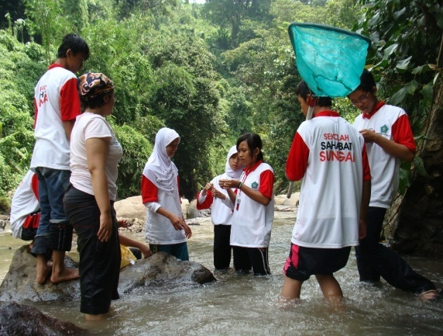
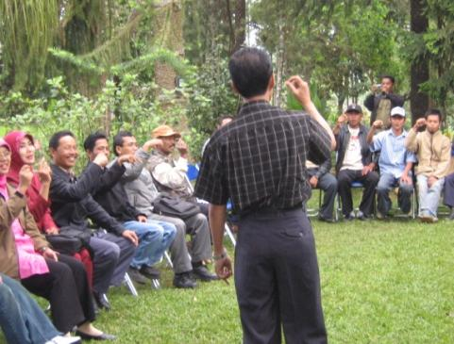
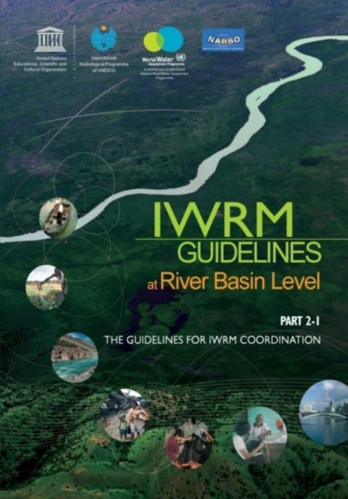
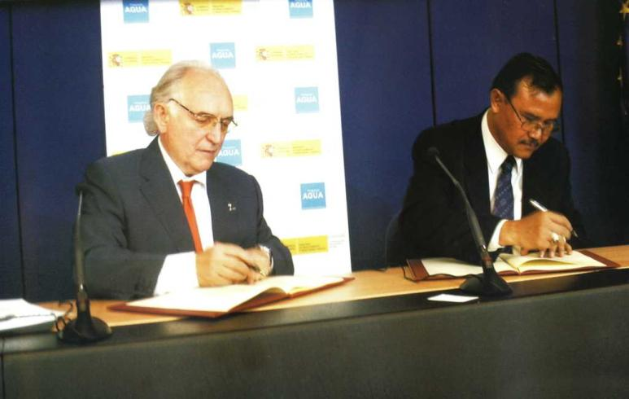
Thank you for your attention

